Slide 1
What Are You Studying?
Revisiting the Liberal Arts Brand and Identity
2018 NACADA National Conference - Phoenix, AZ
Jordan Berken - Academic Advisor, University of Wisconsin-Madison
Sarah Seibold - Academic Advisor, University of Wisconsin-Madison

Slide 2
Setting the Stage
What’s the issue?
What are we envisioning?
How are we doing it?
Challenges we’re encountering
Moving forward (together)

Slide 3
What’s the issue?

Slide 4
What's the Issue?
Conflicting narratives
L&S students tend to identify solely with major
“Backburner” classes / “getting requirements out of the way”
Underselling degree upon graduation

Slide 5
What are we envisioning?

Slide 6
What are we envisioning?
(Re)focused emphasis on the degree
A more pronounced Liberal arts (L&S) student identity to compliment identity with major department
Rebranding L&S as a destination college.
"Reaching across the (academic) aisle"
Students seeing the opportunity of non-major coursework, rather than requirements to be checked off

Slide 7
How are we doing it?

Slide 8
Visuals and Messaging

Slide 9
Words matter
Degree vs. major
Undecided
Liberal
“Getting XYZ out of the way”

Slide 10
First/second-year Seminars
Incorporating conversations about the curriculum into the curriculum
Encouraging conversations about the liberal arts early and often

Slide 11
First-year Interest Groups (FIGs)

Slide 12
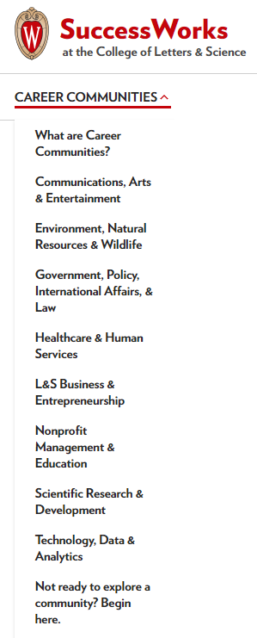
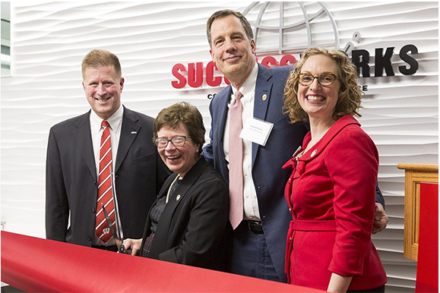
Career development in the liberal arts

Slide 13
Challenges we’re encountering

Slide 14
Deeply-rooted societal narratives
“If you are going to study 16th-century French art, more power to you. I support the arts, but you are not going to get a job.”
-Sam Clovis (2016 Trump Campaign national co-chair and policy director)
“I promise you folks can make a lot more, potentially, with skilled manufacturing or the trades than they might with an art history degree.”
-Barack Obama
“Is it a vital interest of the state to have more anthropologists? I don’t think so.”
-Florida Governor Rick Scott

Slide 15
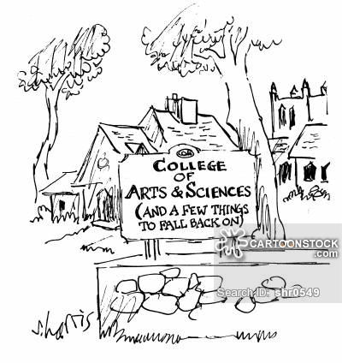
L&S as “default” or “backup” college

Slide 16
"Underwater Basket Weaving"

Slide 17
Pushing students to claim/own/value entire curriculum
"An excellent advisor does the same for a student’s entire curriculum that the excellent teacher does for one course."
-Lowenstein (2005)

Slide 18
Moving forward (together)

Slide 19
Thank you for the discussion!
We'll be in touch.

